Slide 1
Welcome to the
3rd Working Group Meeting on
RCARO’s Future Role
Jeju, 19-21 January 2016

Slide 2
IAEA’s Role under the
1987 RCA Agreement
Sinh Van Hoang (PhD)
RCA Focal Person
Jeju, 19-21 January 2016

Slide 3
Background
  The original agreement (the “1972 RCA”) was concluded in 1972 for a period of five years, and extended for successive five-year periods in 1977 and in 1982.
  In 1987, the 1972 RCA was replaced by the 1987 RCA currently in force (till 11 June 2017).
  RCA Medium Term Strategy 2012-2017 & Strategic Priorities for 2012-2017; RCA Medium Term Strategy 2018-2023; and RCA Guidelines and Operating Rules (GOR) were adopted.

Slide 4
IAEA’s Role under the 1987 RCA
  The IAEA is not a Party to the 1987 RCA;
  Any obligations on the Agency can only arise if the Agency expressly accepts them, and must be strictly interpreted within the limits of such acceptance. For the Agency, the BoG is the organ empowered to express the acceptance of such obligations;

Slide 5
IAEA’s Role under the 1987 RCA
  The IAEA cannot be considered as the “Secretariat of the RCA” and the concept of “secretariat duties” is to be restrictively interpreted based on the text of the Agreement itself, in particular since the 1987 RCA makes no provision for the funding of the individuals that perform such duties. The “secretariat duties” of the Agency are, therefore, only those expressly envisaged by the Agreement itself, such as the duty to convene the RCA Meetings of Representatives (Article II.1), and the duty to receive relevant communications from GPs and/or to notify other GPs of such communications or other relevant information (Article III.1; Article IV.1; Article V.2; Article V.3; Article VIII.1).

Slide 6
IAEA’s Role under the 1987 RCA
Besides “secretariat duties” and depositary functions, the IAEA has a number of other obligations:
“to encourage and assist research on, and the development and practical application of, atomic energy for peaceful uses” (Preamble);

Slide 7
IAEA’s Role under the 1987 RCA
“to support cooperative projects established in accordance with Article III by means of technical assistance and its other programmes” (Article VII.2). This obligation is, however, “subject to available resources” and “provided, mutatis mutandis, in accordance with the principles, rules and procedures governing the provision of technical assistance by the Agency.”

Slide 8
IAEA’s Role under the 1987 RCA
“to establish annually a schedule of work and modalities for the implementation of the co-operative project” (Article VII.3);
“to allocate among the GPs the contributions made …..” (Article VII.3);
“to consider annual reports submitted by the GPs on implementation of their portion ……..” (Article VII.3);

Slide 9
IAEA’s Role under the 1987 RCA
“to assist the GPs in the exchange of information and in compiling, publishing and distributing reports ….” (Article VII. 3);
“to provide scientific and administrative support for the meetings of the project committee” (Article VII. 3);
“to prepare annually an overall report on the activities carried out under the RCA”, but on the basis of the annual reports submitted by the Participating Governments (Article VII. 4).
Notes:
Notes to Point 5. OLA: In addition, Article VI requires the Agency is to be represented by one person within the “project committee” to be established for any project under Article III. On the basis of recommendations made by the project committee, the Agency is to perform a number of specific functions under Article VII.3: (a) establish annually a schedule of work and modalities for the implementation of the project; (b) allocate among the Participating Governments the contributions to the project; (c) consider annual reports to be submitted by the Participating Governments on the implementation of their portion of the project; (d) assist the Participating Governments in the exchange of information and in compiling, publishing and distributing reports on the project, “as appropriate”; and (e) provide scientific and administrative support for the meetings of the project committee. Finally, under Article VII.4, the Agency is also expected to prepare annually an overall report on the activities carried out under the RCA, but on the basis of the annual reports to be submitted by the Participating Governments.
Note to Point 6. RCA Agreement Article VII.4

Slide 10
IAEA’s Role under the 1987 RCA
  All of the functions of the Agency under the 1987 RCA, as briefly summarized above, have to be restrictively interpreted based on the text of the Agreement itself since, as was pointed out above, the IAEA is not a Party thereto.
  The Agency is, in particular, not bound by broader interpretations that may have been adopted by the GPs through the RCA GOR or otherwise.

Slide 11
IAEA’s Involvement in RCA Projects not Funded through the IAEA
  The main purpose of the Agreement is to further cooperation among the GPs within the context of the Agency’s own function to “encourage and assist research on, and the development and practical application of, atomic energy for peaceful uses”.
  The 1987 RCA does not envisage the participation of the GPs in cooperative projects with no involvement of the IAEA – “GPs in cooperation with each other and the Agency” and the IAEA’s involvement is required, though in varying degrees, in all projects thereunder.

Slide 12
IAEA’s Involvement in RCA Projects not Funded through the IAEA
  This does not mean that the RCA forbids the GPs to promote, develop and participate in such cooperative projects, but only that such projects would not fall within the umbrella of the 1987 RCA.

Slide 13
Thank you for your attention!

Slide 14
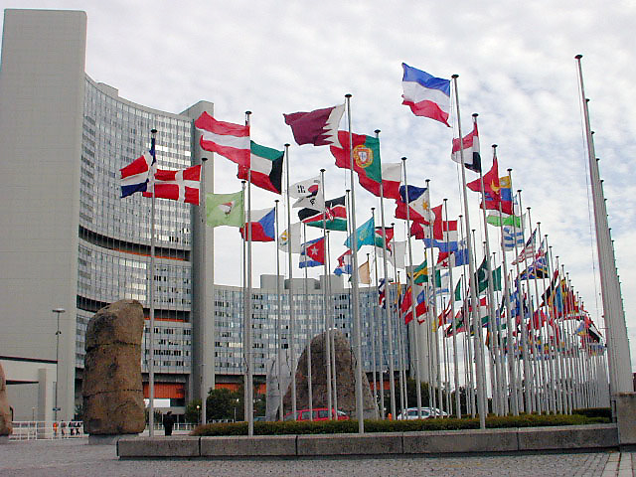
Atoms for
Peace and Development!

